Slide 1


HearthStone Card Database
By: Santosh Lakshman, Barr Avrahamov, Gokul Nair, Noah Gutierrez

Slide 2
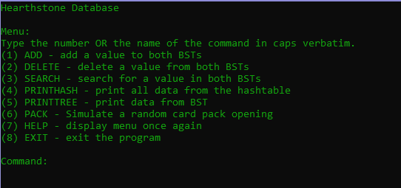
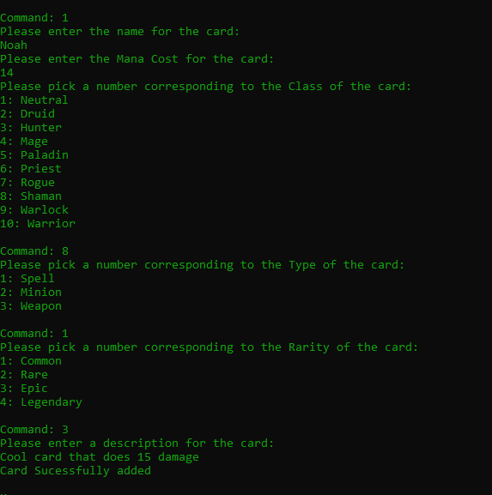
Features *ADD SCREENSHOTS*
View Hash Table
View Elements
View Hash Table Efficiency
View Binary Search Tree
View Elements
View Binary Search Tree Efficiency
Add Cards
Remove Cards
View cards sorted by mana
Simulate Card Pack opening
Exit

Slide 3
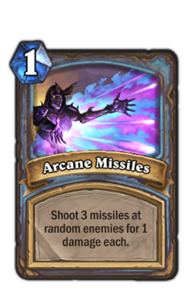
Spell Card Class
Attributes
manaCost(int)
rarity(enum COMMON, RARE, EPIC, LEGENDARY)
cardClass(enum NEUTRAL, DRUID, HUNTER, MAGE, PALADIN, PRIEST, ROGUE, SHAMAN, WARLOCK, WARRIOR)
Description (string - What the card does)
flavorText (string - Story behind the card)
sortKey(enum NAME, MANA, CLASS, RARITY, DESCRIPTION)

Slide 4
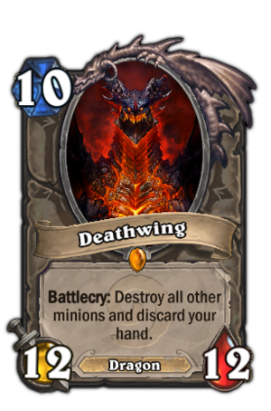
Minion Card Class: inherited from Spell
Attributes
attackValue(int)
healthValue(int)

Slide 5
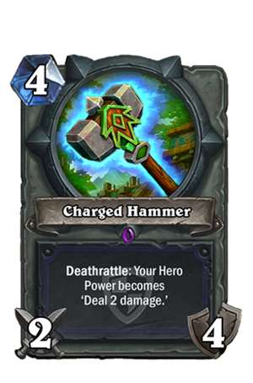
Weapon Card Class: inherited from Spell
Attributes
attackValue
durability

Slide 6
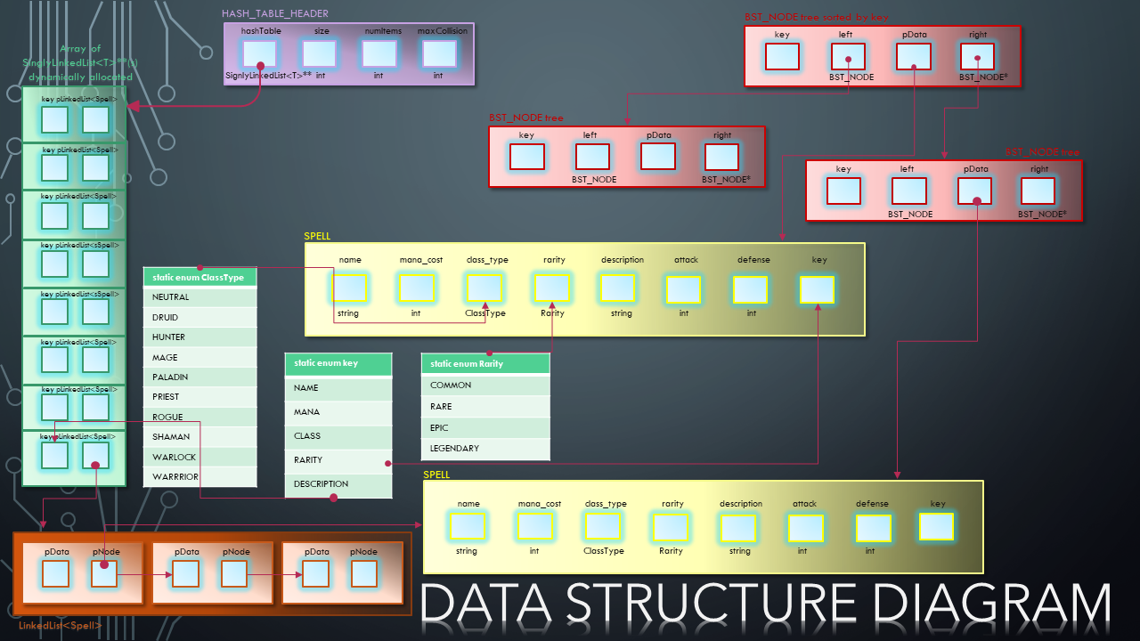
Data Diagram

Slide 7
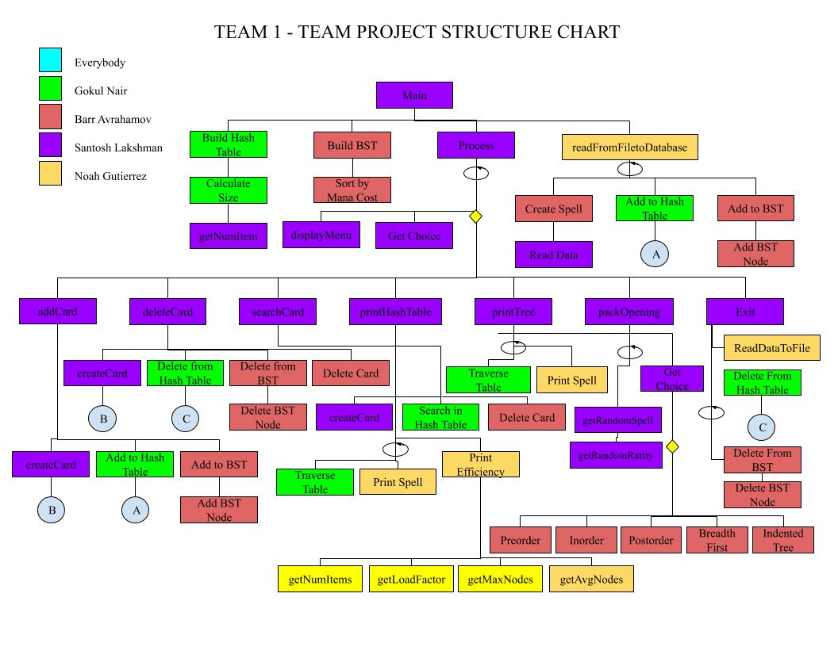
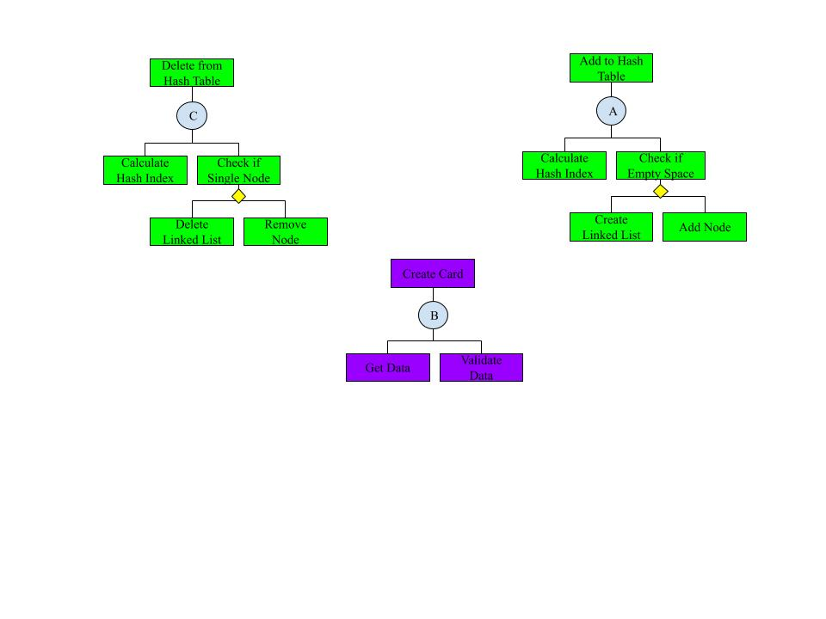
Structure CHart

Slide 8
Hash Table and Linked list
Hash Function: (17 * sum of characters in name + 29) % size
Collision resolution using Linked List
When there is a collision, the new element is added to the end of a linked list at that index
All below values are before user adds any cards
Load Factor - 70%
Allows a buffer for user to add cards and be under the conventional 75% Load Factor
Longest Linked List – 3 nodes
Average Nodes per index – 1.35135 nodes
Average number of actual operations to insert/find data in BST - 3.91202

Slide 9
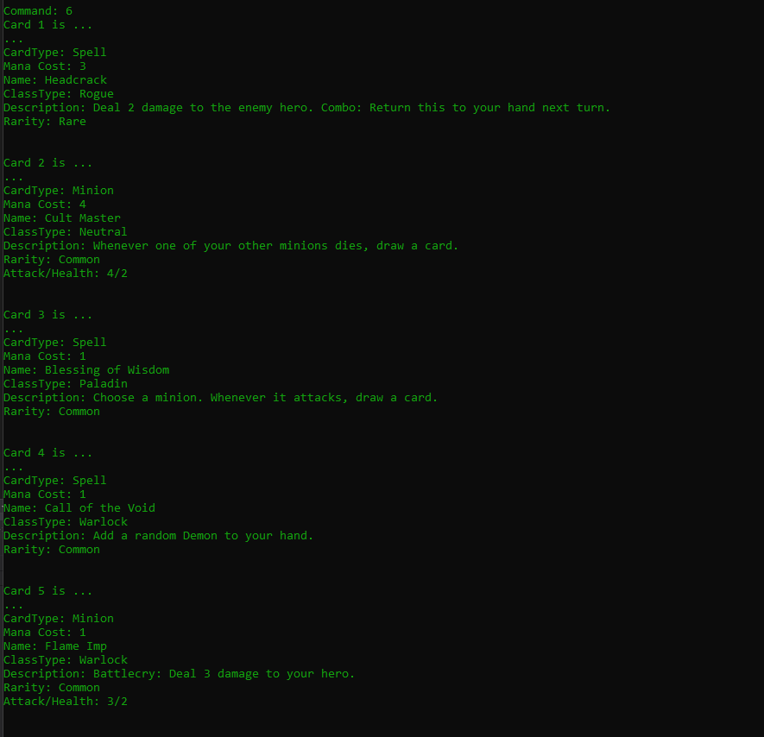
Pack Opening
Simulates a 5 card pack opening from the game
You are given 5 random cards
The type of cards you get are based on rarity
Higher rarity cards are less common

Slide 10
Demonstration

Slide 11
Thanks for watching!

